Slide 1
Medisure
Healthcare Claims Quality & Compliance
Capstone Project (Azure Databricks)

Slide 2
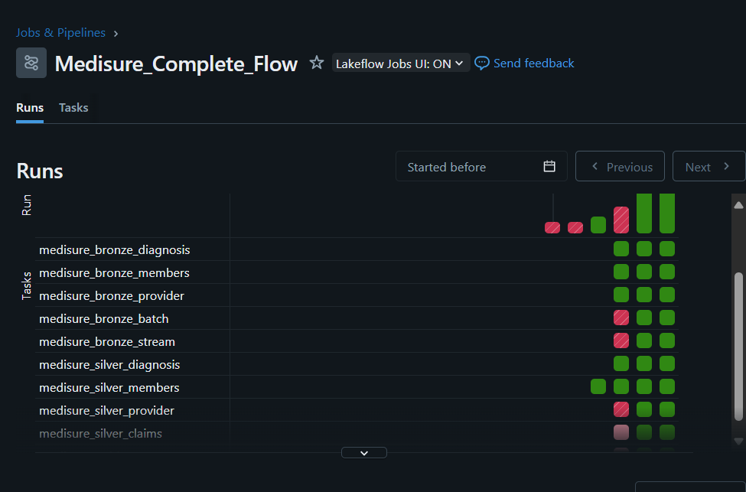

Slide 3
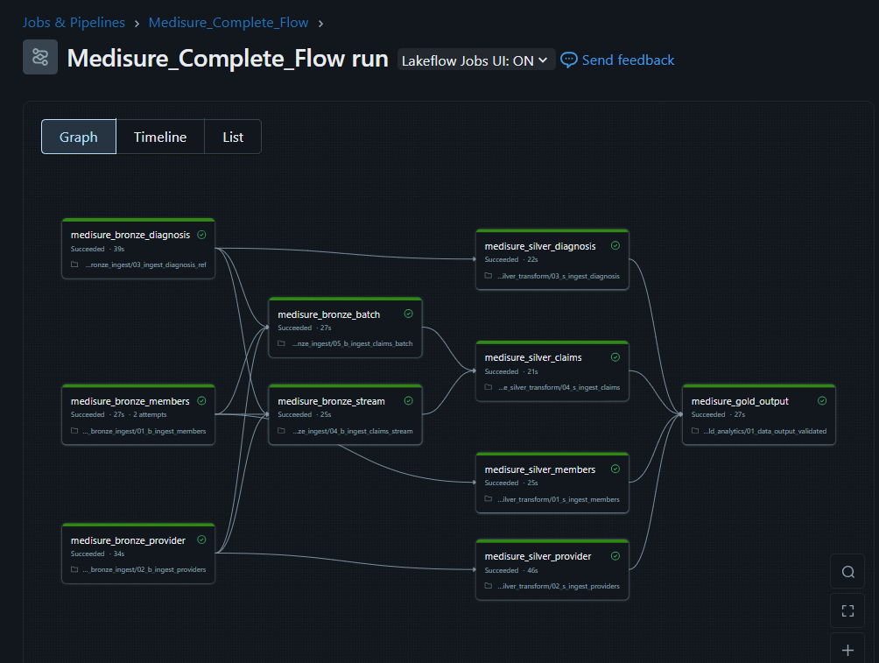

Slide 4
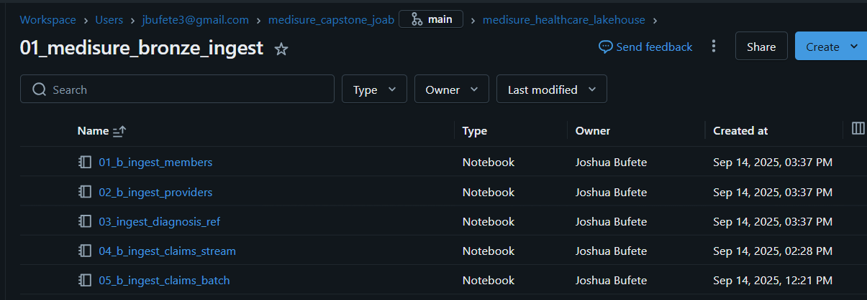
Bronze Notebook

Slide 5
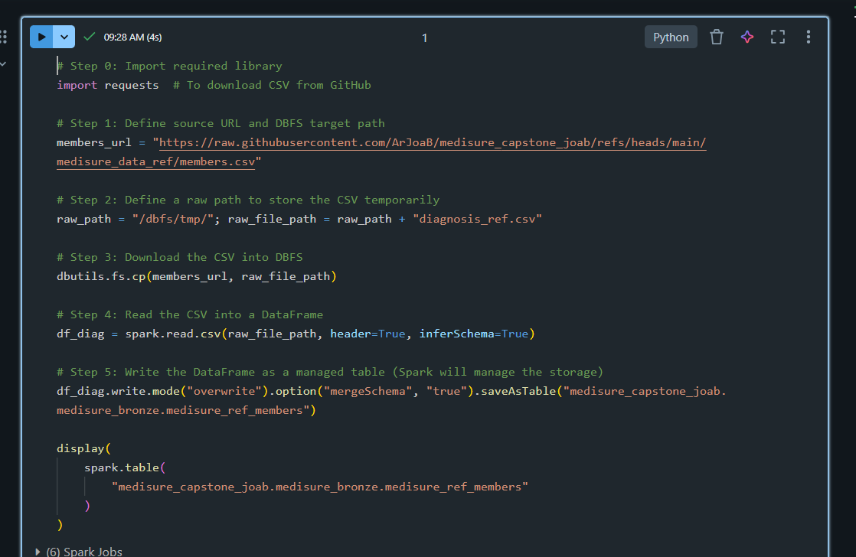
Bronze Members Table

Slide 6
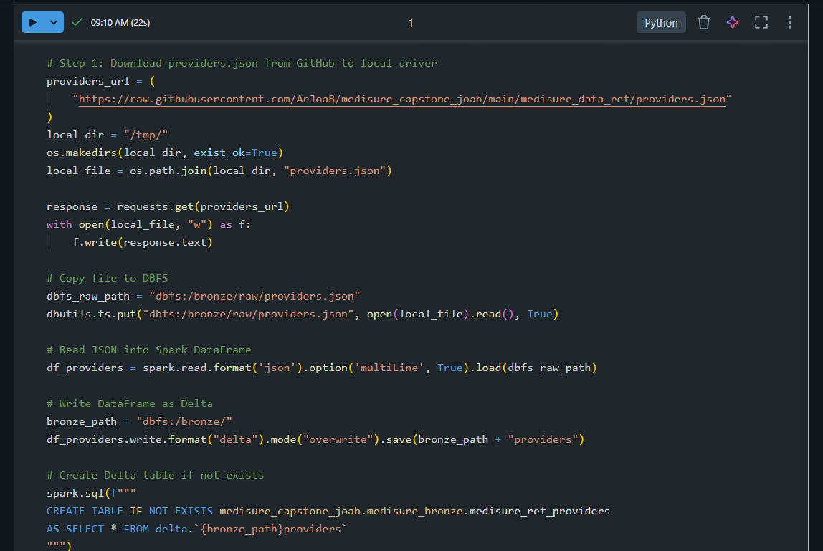
Bronze Providers Table

Slide 7
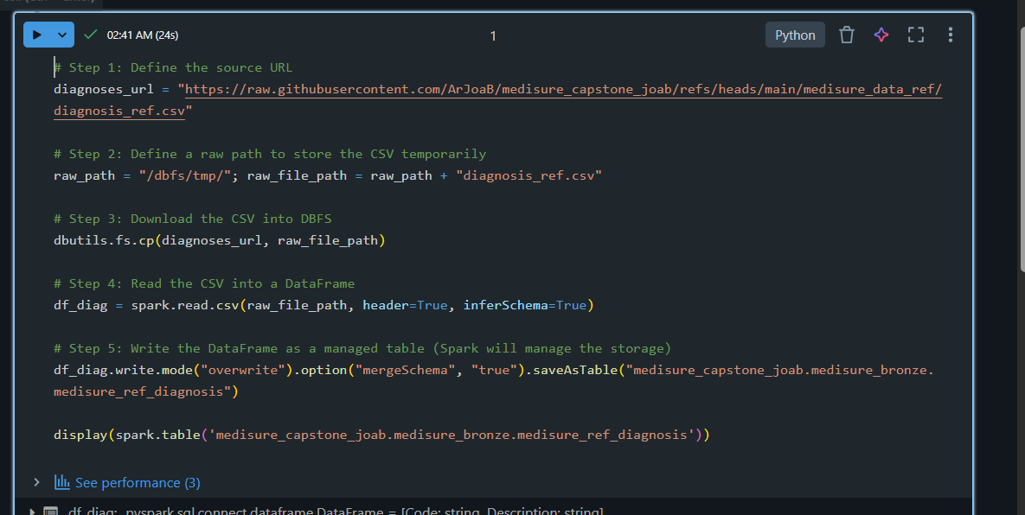
Bronze Diagnosis Table

Slide 8
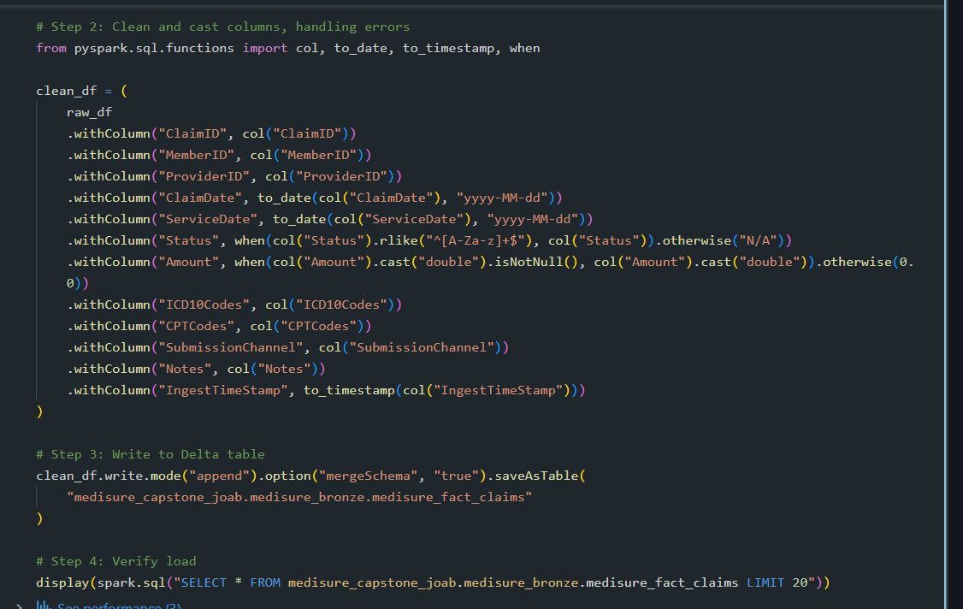
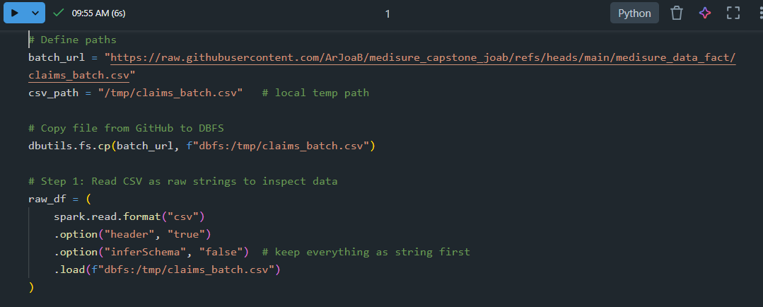
Bronze Claims Table (Batch)

Slide 9
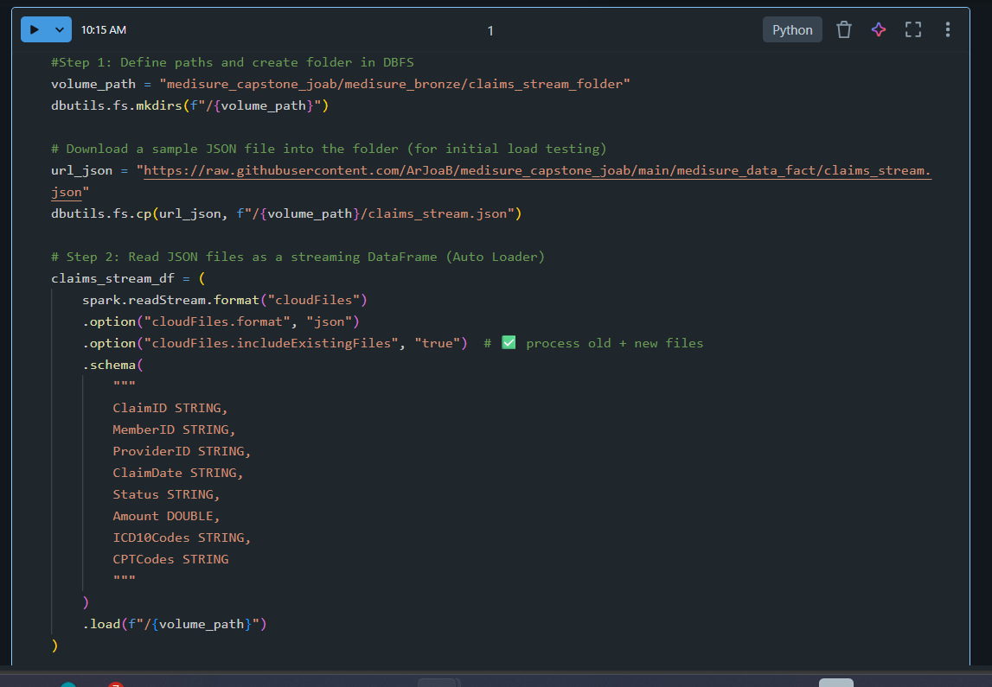
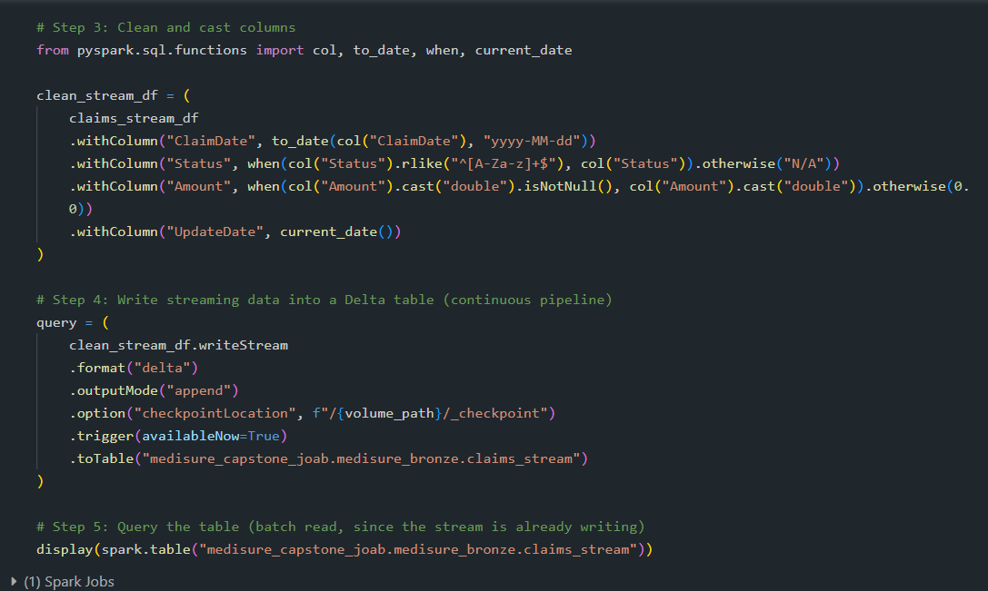
Bronze Claims Table (Stream)

Slide 10
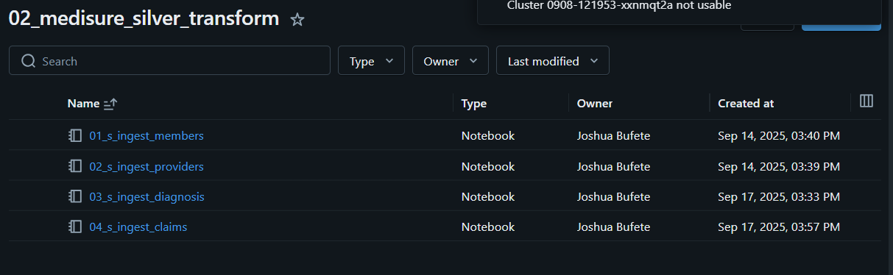
Silver Notebook

Slide 11
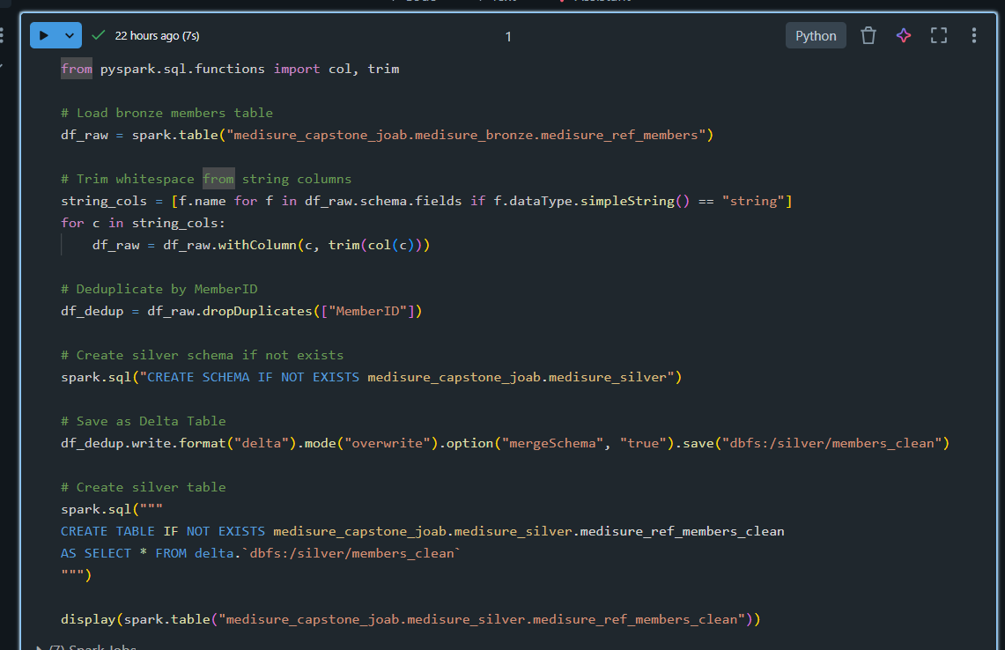
Silver Members Table

Slide 12
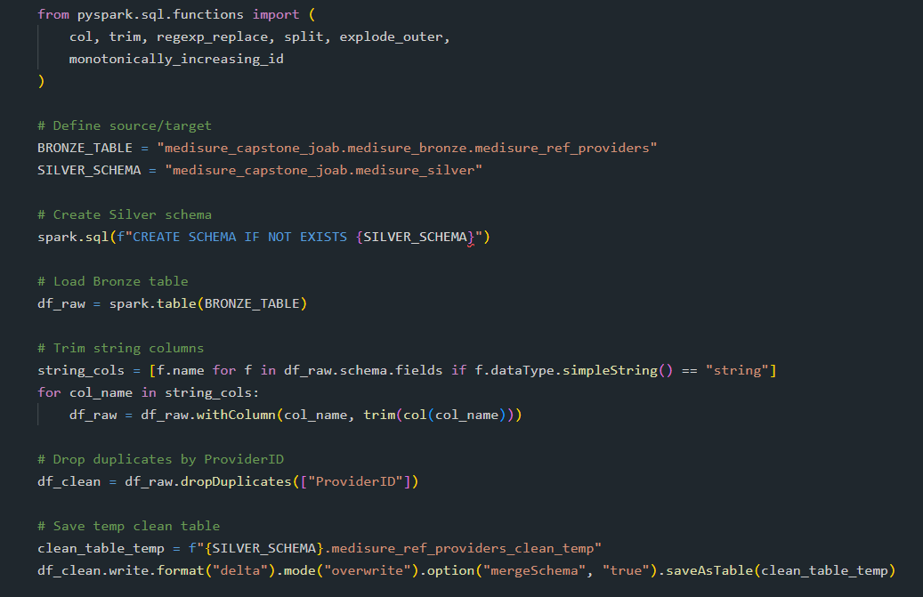
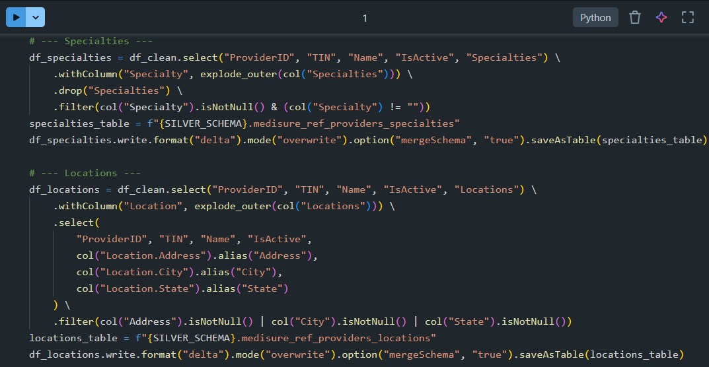
Silver Providers Table

Slide 13
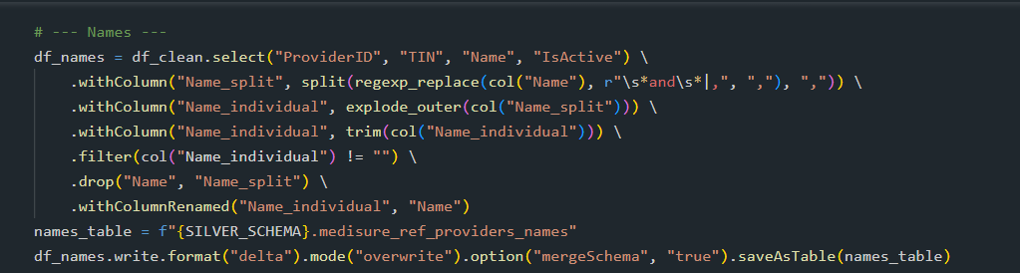
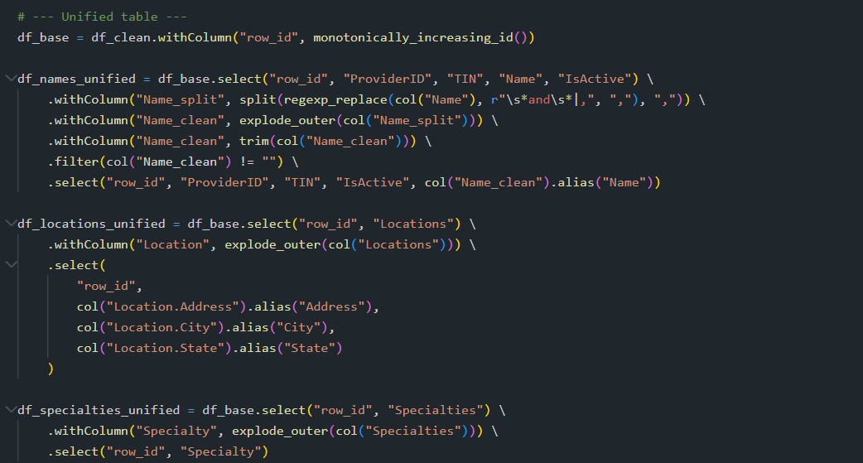
Silver Providers Table

Slide 14
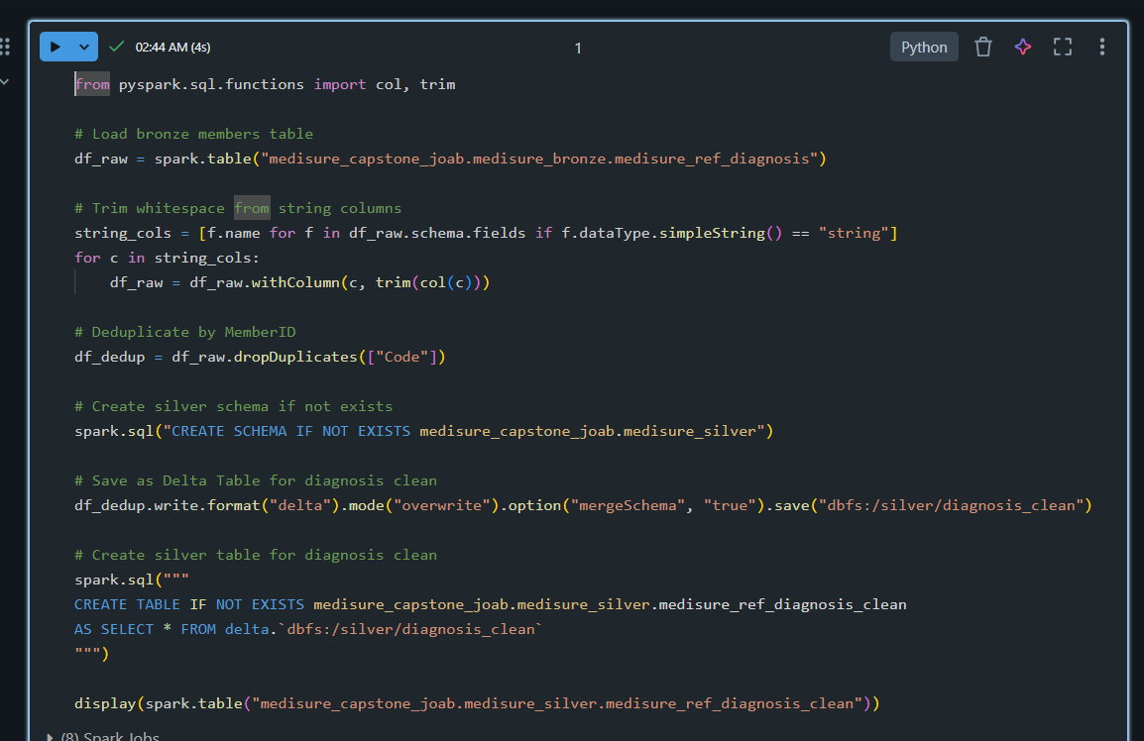
Silver Diagnosis Table

Slide 15
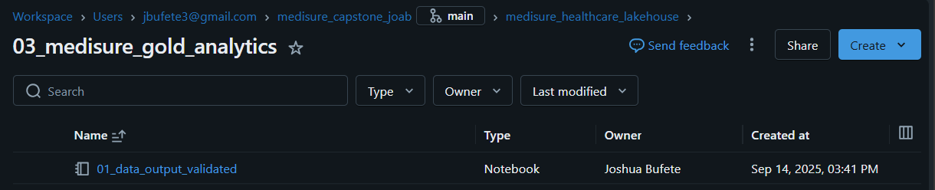
Gold Notebook

Slide 16
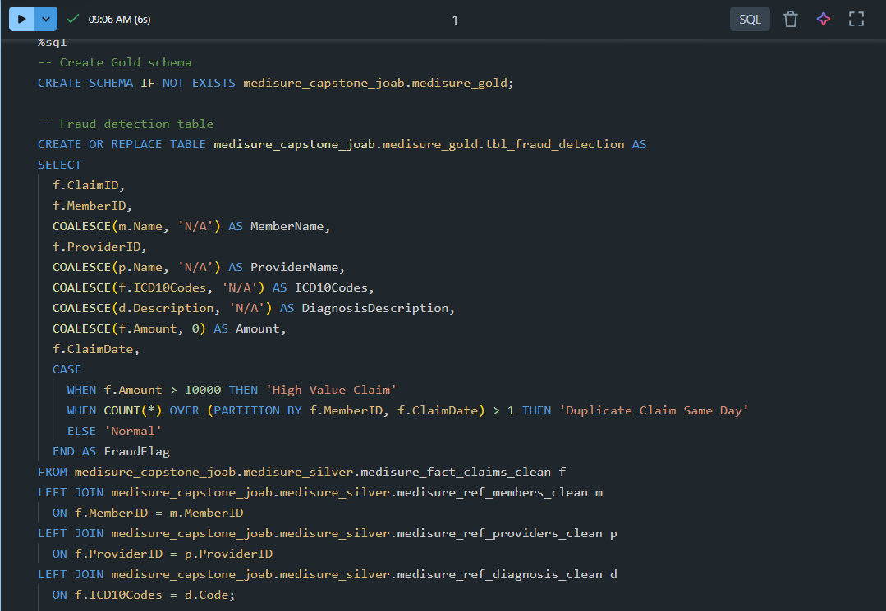
Gold Output Tables (Fraud Detection)

Slide 17
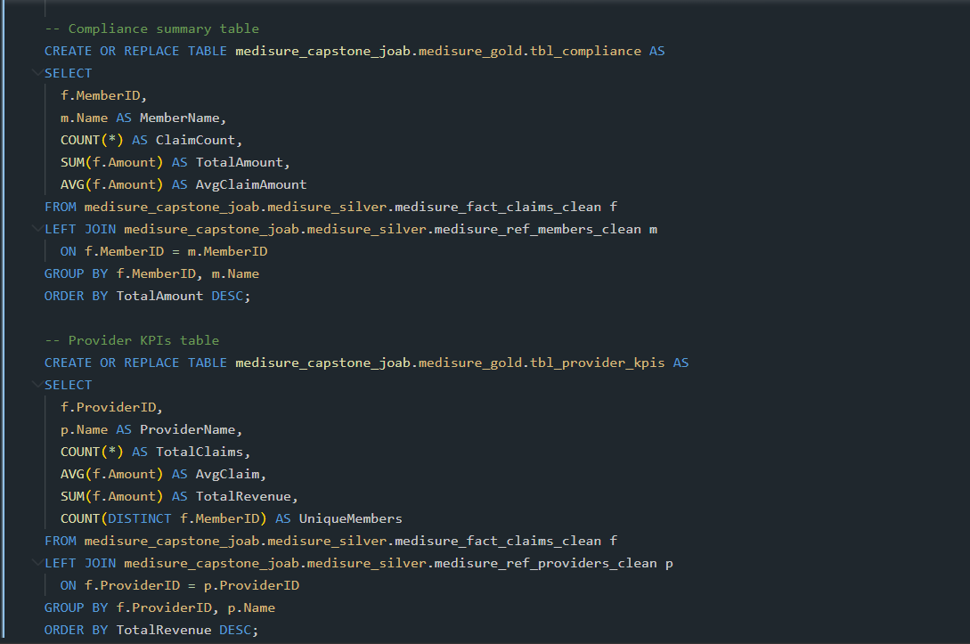
Gold Output Tables (Compliance Summary & Providers KPI)

Slide 18
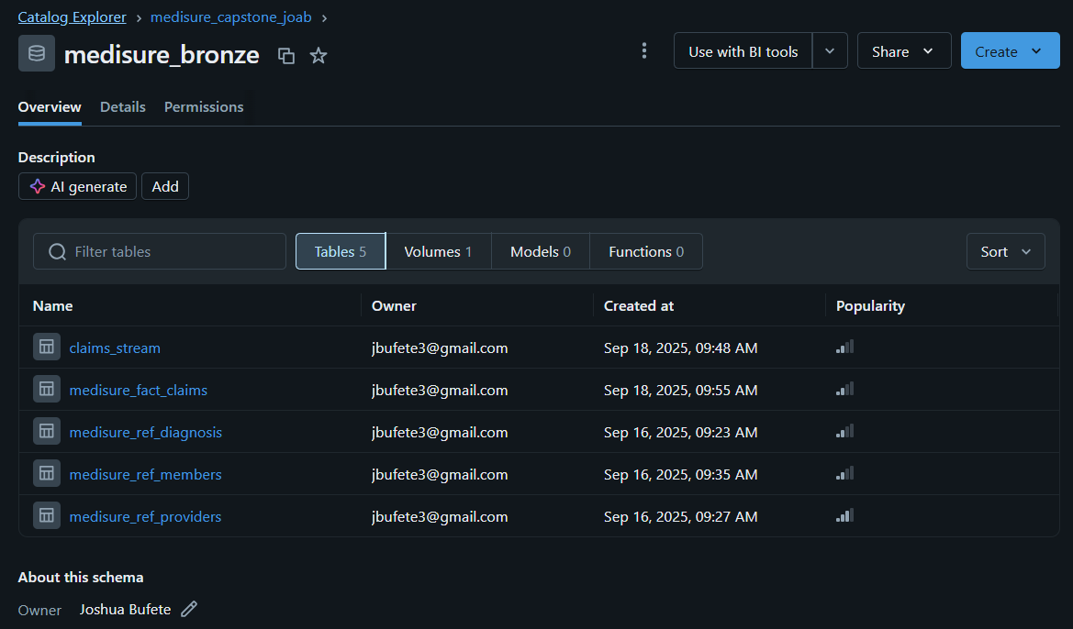
Bronze Schema

Slide 19
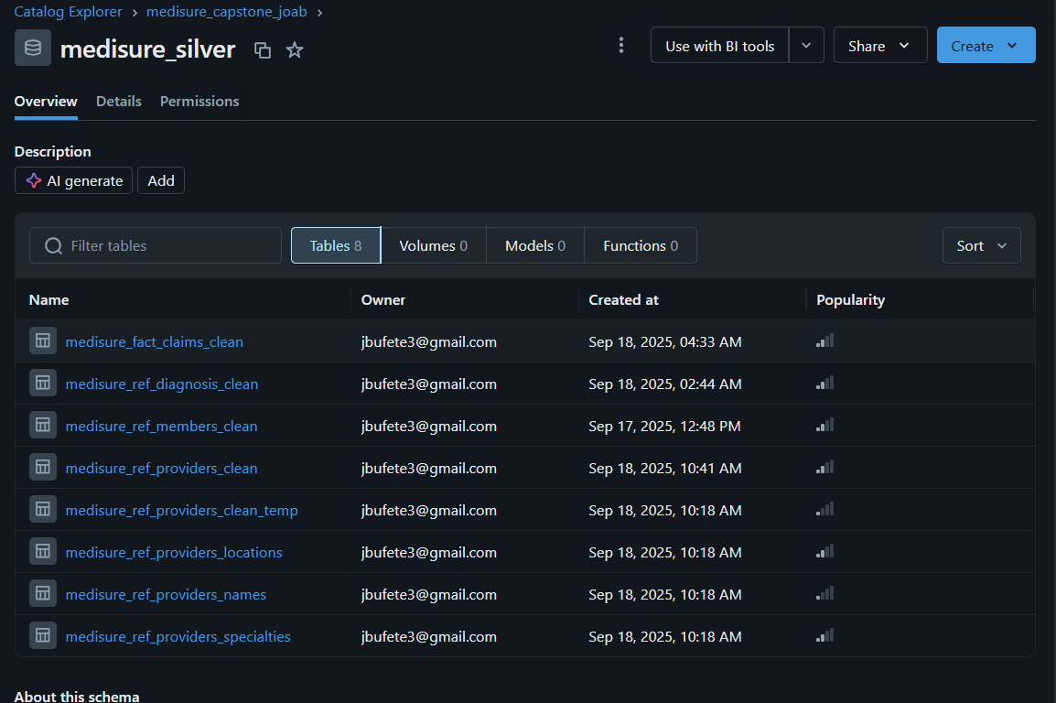
Silver Schema

Slide 20
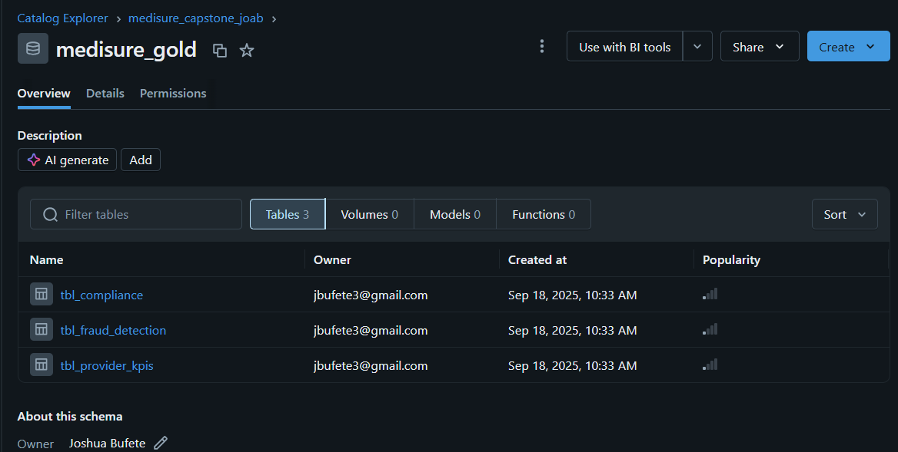
Gold Schema

Slide 21
Thank you

